Slide 1

GROUP 5 | MCA · BIG DATA PROJECT
SMART LIBRARY
MANAGEMENT
Library Usage Analytics & Data-Driven Insights using Apriori, K-Means Clustering, and Personalized Recommendations
DATASET: Library_Management_Dataset.xlsx · 500 STUDENTS
SMART LIBRARY MANAGEMENT | GROUP 5 · MCA
1

Slide 2








ROADMAP
Agenda
01
02
03
Introduction
Problem Statement
Methodology
04
05
06
System Architecture
Workflow
Technology Stack
07
08
09
Implementation
Results & Discussion
Future Scope
SMART LIBRARY MANAGEMENT | GROUP 5 · MCA
2

Slide 3




INTRODUCTION
Background & Scope
Background
Modern academic libraries generate rich behavioural data — book borrowing, digital-resource access, visit frequency, and reading duration — that is rarely analysed beyond basic circulation counts.
500 unique students across the library system
Genre preference, borrowing & digital-resource usage
Scope of Study
This project applies data mining techniques to a 500-student library usage dataset to uncover usage patterns, segment students by behaviour, and generate actionable, data-driven recommendations for library management. The analysis combines association rule mining (Apriori), unsupervised clustering (K-Means), and a lightweight recommendation engine into a single analytics-driven workflow, visualised through an interactive dashboard.
Peak hours, visit frequency & reading duration
Behavioural segmentation via K-Means clustering
SMART LIBRARY MANAGEMENT | GROUP 5 · MCA
3

Slide 4

PROBLEM STATEMENT
Existing Problem & Objectives
The Existing Problem
Project Objectives
Library usage data is collected but rarely analysed beyond raw counts.
Profile overall library usage: borrowing, digital access, reading time.
No visibility into which genres, hours, or services drive real demand.
Mine association rules linking genre, visit reason, and peak hours.
Book purchasing and staffing decisions are made without data support.
Segment students into behavioural clusters using K-Means.
Students receive no personalized reading or resource suggestions.
Generate genre-based recommendations and purchase priorities.
SMART LIBRARY MANAGEMENT | GROUP 5 · MCA
4

Slide 5


METHODOLOGY
Analytical Approach
01
02
03
04
→
→
→
Data Collection
Preprocessing
Modeling
Evaluation
500-record Excel dataset of student library activity
Cleaning, type conversion & feature selection
Apriori rules, K-Means clustering, recommender logic
Silhouette score, rule confidence & lift, visual QA
Techniques used: Apriori (association rule mining) · K-Means clustering · Rule-based recommendation system
SMART LIBRARY MANAGEMENT | GROUP 5 · MCA
5

Slide 6
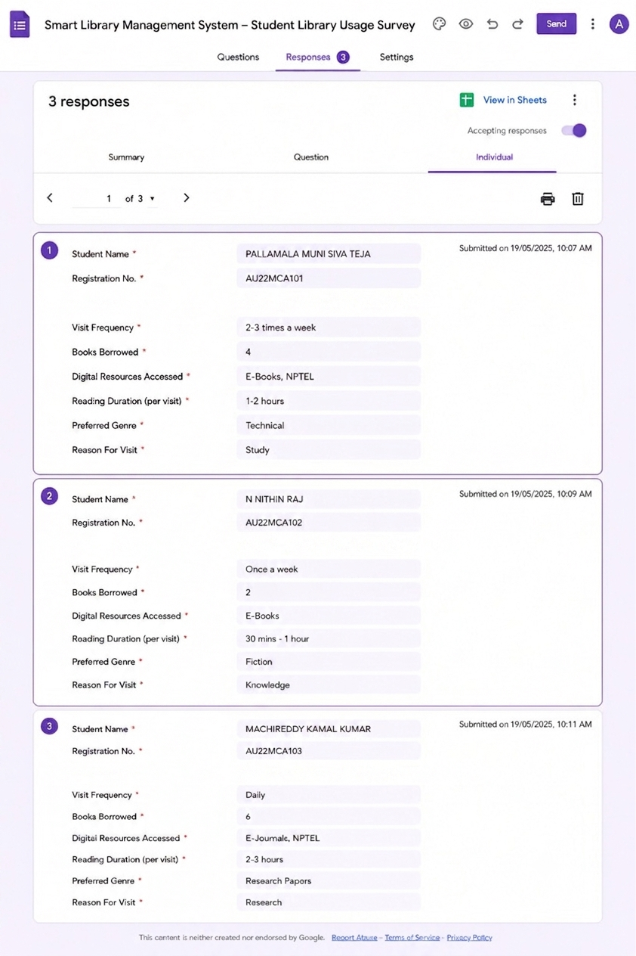
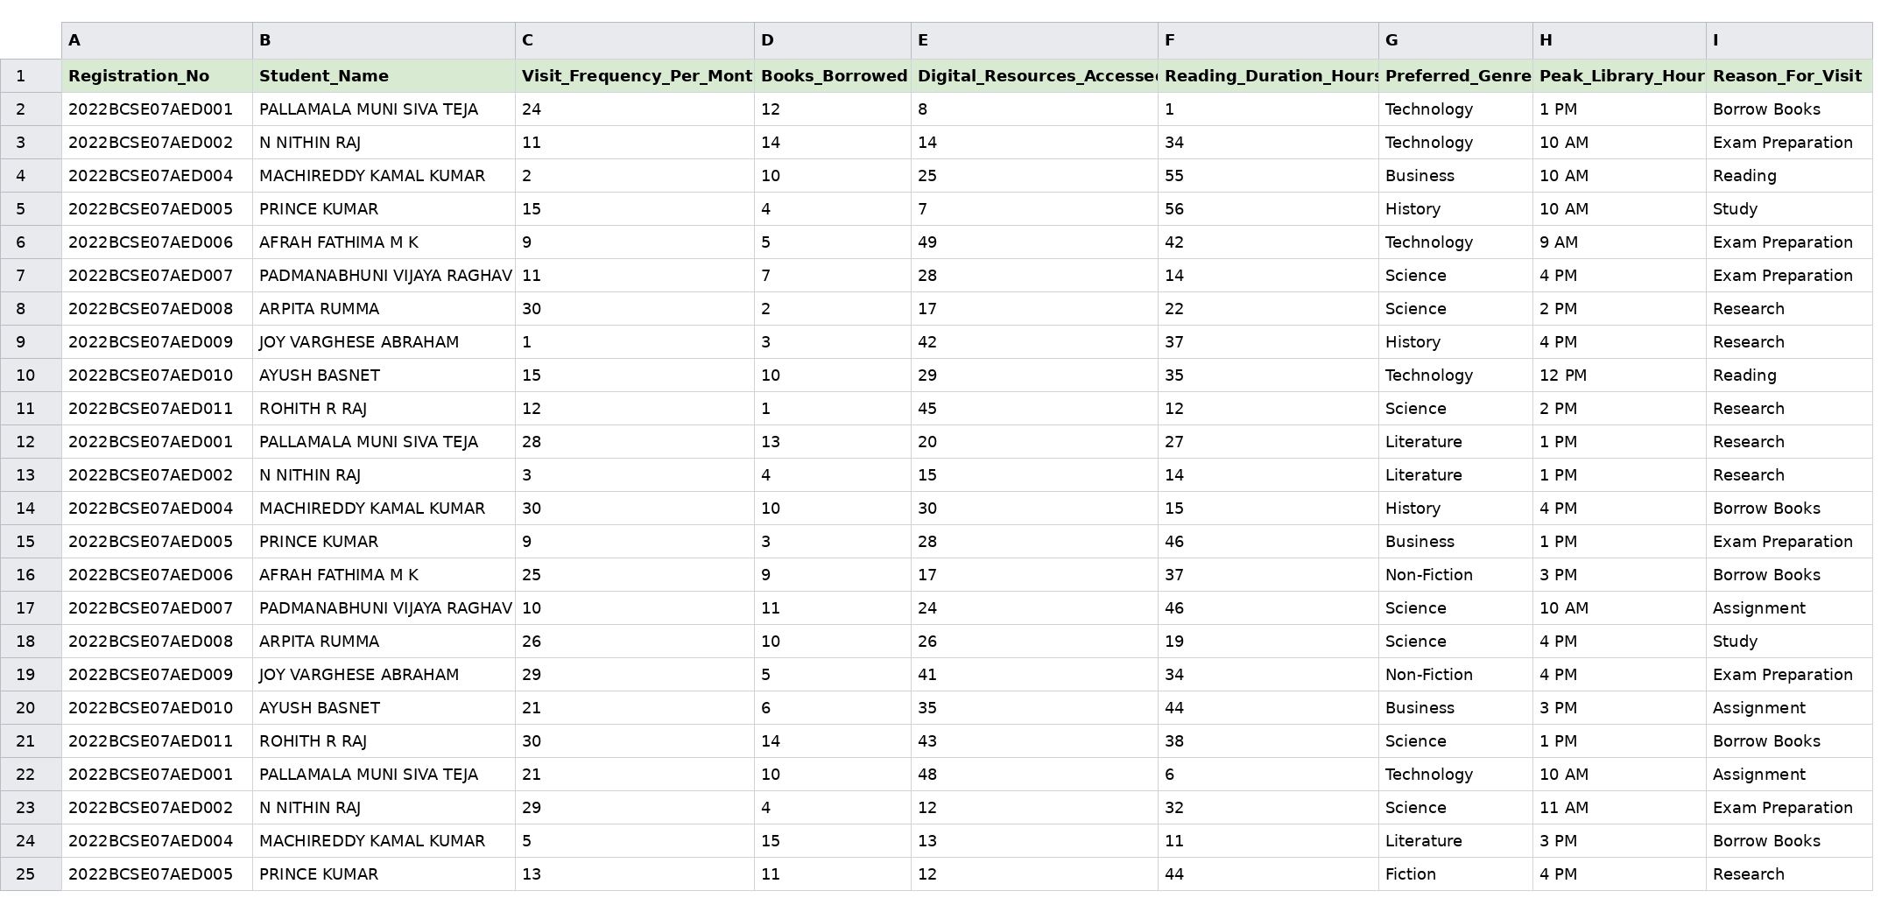
DATA COLLECTION
Google Form Survey → Structured Dataset
Google Form Survey
Consolidated Dataset
A structured Google Form was used to pilot data collection — capturing visit frequency, borrowing, digital-resource use, reading duration, genre and reason for visit.
Open the Google Form
Responses were consolidated and scaled into the full 500-record working dataset (Library_Management_Dataset.xlsx) used for Apriori, K-Means and the recommendation engine.
SMART LIBRARY MANAGEMENT | GROUP 5 · MCA
6

Slide 7
SYSTEM ARCHITECTURE
Data Source → Processing → Model → Output
→
→
→
Data Source
Processing
Model Layer
Output
Library_Management_
Dataset.xlsx (500 rows)
Pandas cleaning,
encoding & scaling
Apriori · K-Means ·
Recommendation logic
Insights dashboard &
recommendations
Flow: raw records are cleaned and transformed, mined for patterns and clusters, then surfaced through a dashboard that drives library decisions.
SMART LIBRARY MANAGEMENT | GROUP 5 · MCA
7

Slide 8


WORKFLOW
Problem → Literature → Development → Conclusion
1
2
3
4
5
→
→
→
→
Problem
Literature
Development
Testing
Conclusion
Defined the analytics problem and success criteria for the library.
Reviewed data-mining approaches: association rules & clustering.
Built the cleaning, modeling & dashboard pipeline in Python.
Validated cluster quality and rule confidence against the data.
Summarized findings into actionable library recommendations.
SMART LIBRARY MANAGEMENT | GROUP 5 · MCA
8

Slide 9

TECHNOLOGY STACK
Tools & Libraries Used
Python
Jupyter Notebook
Pandas
Core programming language for the entire analysis
Interactive environment for exploration & modeling
Data loading, cleaning & aggregation
Matplotlib / Seaborn
Scikit-learn
Mlxtend
Exploratory & cluster visualizations
StandardScaler, K-Means, silhouette scoring
Apriori frequent itemsets & association rules
SMART LIBRARY MANAGEMENT | GROUP 5 · MCA
9

Slide 10
IMPLEMENTATION
Dataset & Algorithms
Dataset Overview
Algorithms Applied
RECORDS
Apriori
500 students (Registration_No unique)
Association rules across Preferred Genre × Reason for Visit × Peak Hour (min support 0.05, confidence 0.30)
KEY FIELDS
Visit Frequency, Books Borrowed, Digital Resources Accessed, Reading Duration
K-Means (k=3)
Segments students on Visit Frequency, Books Borrowed, Digital Resources, Reading Duration
CATEGORICAL FIELDS
Preferred Genre, Peak Library Hour, Reason for Visit
Recommendation Engine
SOURCE FILE
Rule-based genre matching to suggest books & digital resources per student
Library_Management_Dataset.xlsx
SMART LIBRARY MANAGEMENT | GROUP 5 · MCA
10

Slide 11




RESULTS & DISCUSSION
Dashboard Snapshot
500
3,811
12,518
30.8 hrs
Total Students
Books Borrowed
Digital Resources Accessed
Avg Reading Duration
Science leads (82 of 500)
Peak: 9 AM – 12 PM
Exam Prep & Research drive visits
Digital access ~24-27 across levels
Add staff during 9 AM–12 PM
SMART LIBRARY MANAGEMENT | GROUP 5 · MCA
11

Slide 12
RESULTS & DISCUSSION
Library Usage at a Glance
500
3,811
12,518
30.8 hrs
Total Students
Books Borrowed
Digital Resources Accessed
Avg. Reading Duration
Preferred Genre — Demand by Students
Count of Registrations by Peak Library Hour
SMART LIBRARY MANAGEMENT | GROUP 5 · MCA
12

Slide 13
RESULTS & DISCUSSION
Visit Purpose & Association Patterns
Reason for Visit — Share of Students
Apriori — Association Insights
Exam Preparation and Research together account for 192 of 500 visits (~38%) — the two largest visit purposes.
Borrow Books and Reading are near-equal in demand, showing balanced use of physical and quiet-reading services.
Science and Technology are the two most preferred genres, together representing 32% of all preferences.
Visit purpose is fairly evenly distributed across peak hours, with no single hour dominating library traffic.
SMART LIBRARY MANAGEMENT | GROUP 5 · MCA
13

Slide 14
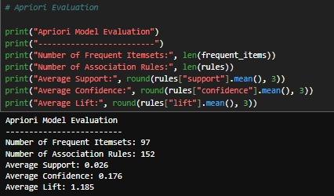
RESULTS & DISCUSSION
Apriori Model Evaluation
Frequent Itemsets, Rules & Quality Metrics
Model Evaluation Summary
Frequent Itemsets
97
Association Rules
152
Average Support
0.026
Jupyter Notebook output — mlxtend Apriori evaluation run on the 500-student transaction data. An average lift above 1.0 confirms the mined rules reflect genuine associations rather than random co-occurrence.
Average Confidence
0.176
Average Lift
1.185
SMART LIBRARY MANAGEMENT | GROUP 5 · MCA
14

Slide 15
RESULTS & DISCUSSION
K-Means Student Segmentation
Cluster Averages — Visit Frequency vs. Reading Duration
Segment Profiles
Frequent Visitors
146 students
High visit frequency (23.3/mo), lighter reading sessions (17.9 hrs).
Deep Readers
166 students
Longest reading duration (44.0 hrs) with fewer, focused visits.
Digital-Heavy Users
188 students
Highest digital-resource access (40.6) alongside strong reading time.
Silhouette score: 0.187
SMART LIBRARY MANAGEMENT | GROUP 5 · MCA
15

Slide 16
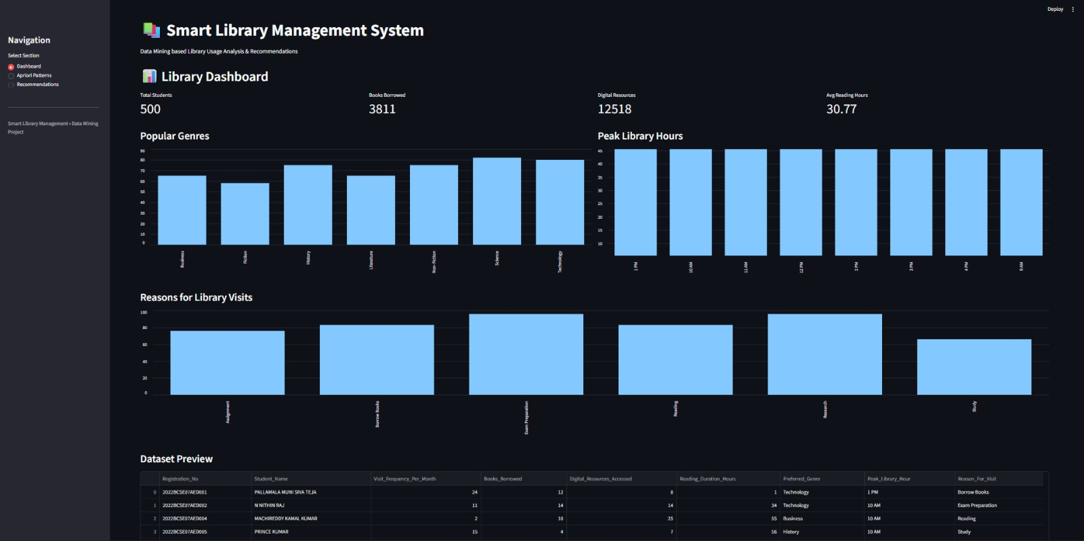
LIVE DEPLOYMENT
Interactive Streamlit Dashboard
Deployed multi-page Streamlit app reproducing the analysis: live KPI totals, genre demand, peak-hour traffic and visit-reason charts.
SMART LIBRARY MANAGEMENT | GROUP 5 · MCA
16

Slide 17
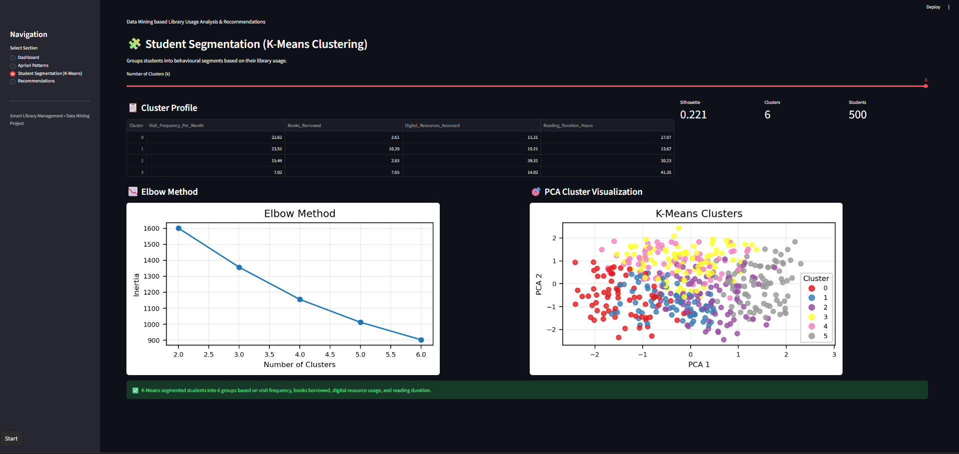
LIVE DEPLOYMENT
Student Segmentation — K-Means Clustering
Same deployed app, K-Means tab: adjustable cluster count, live cluster-profile table, elbow method and PCA scatter for all 500 students.
SMART LIBRARY MANAGEMENT | GROUP 5 · MCA
17

Slide 18
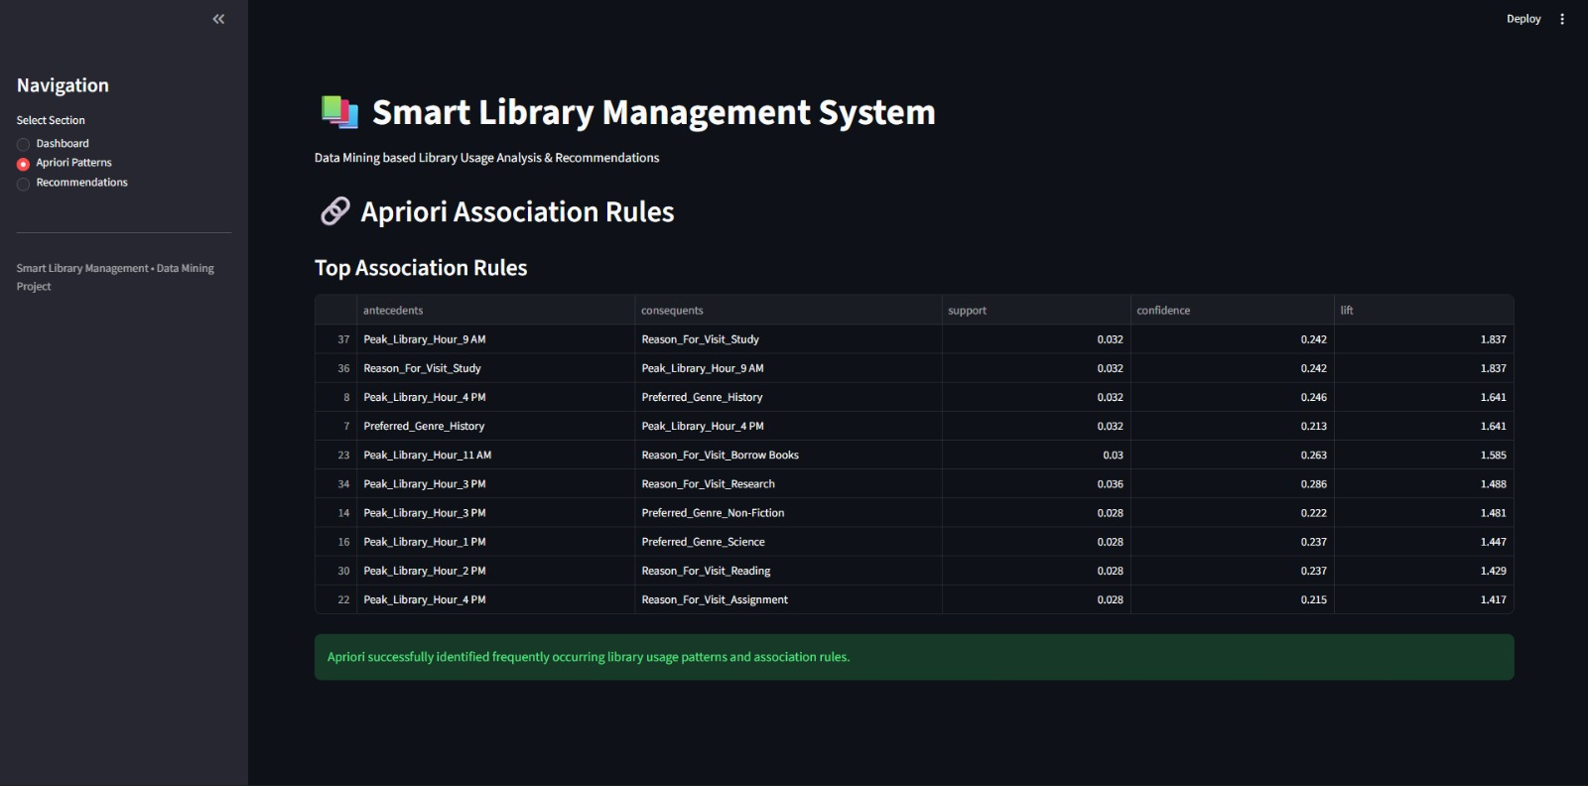
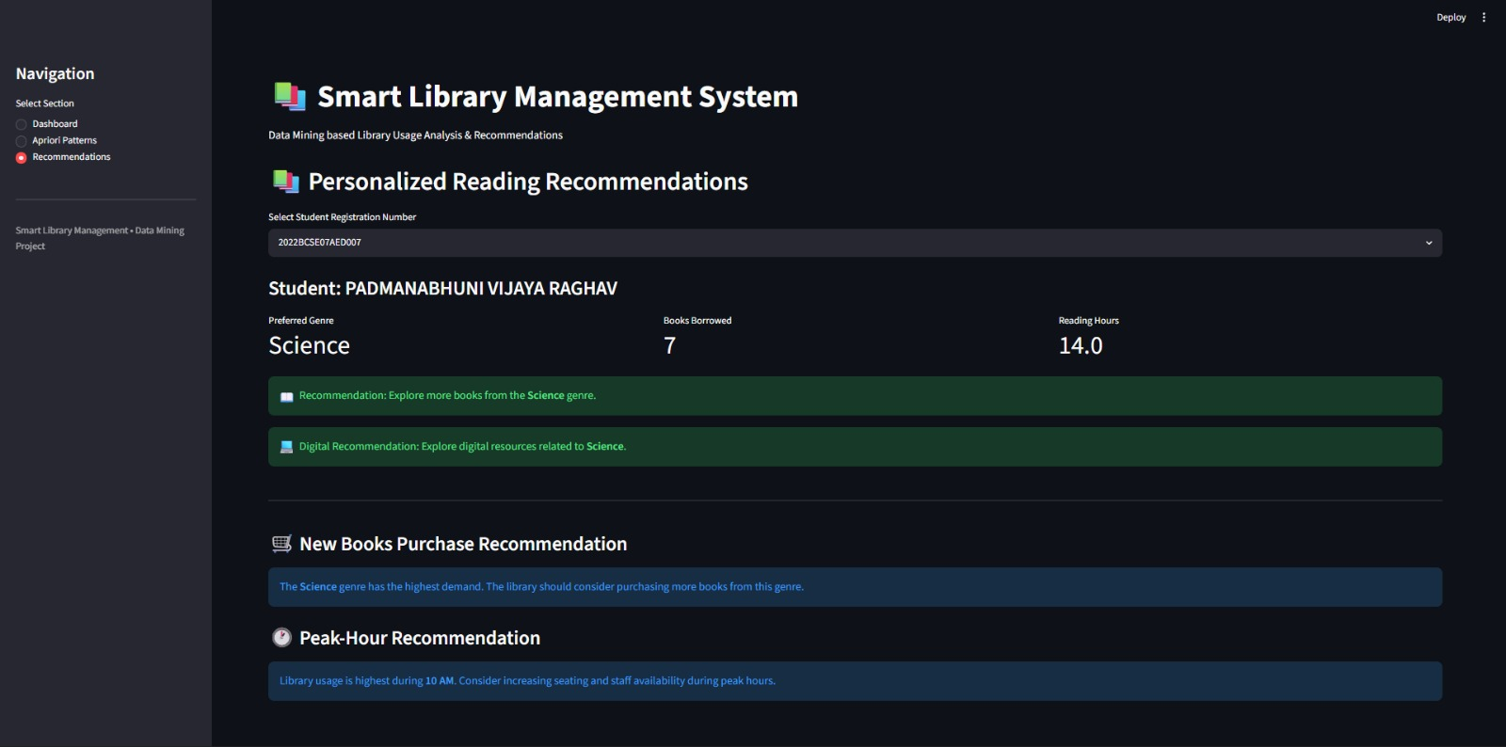
LIVE DEPLOYMENT
Association Rules & Personalized Recommendations
Apriori Association Rules
Personalized Recommendations
Top rules ranked by lift — e.g. Peak Hour 9 AM → Study visits (confidence 24%, lift 1.84) and Peak Hour 4 PM → History genre.
Select any Registration No. to generate genre-based reading & digital-resource suggestions, plus purchase and peak-hour staffing guidance.
Both views are live tabs of the same deployed app — Apriori Patterns and Recommendations — alongside the Dashboard shown previously.
SMART LIBRARY MANAGEMENT | GROUP 5 · MCA
18

Slide 19
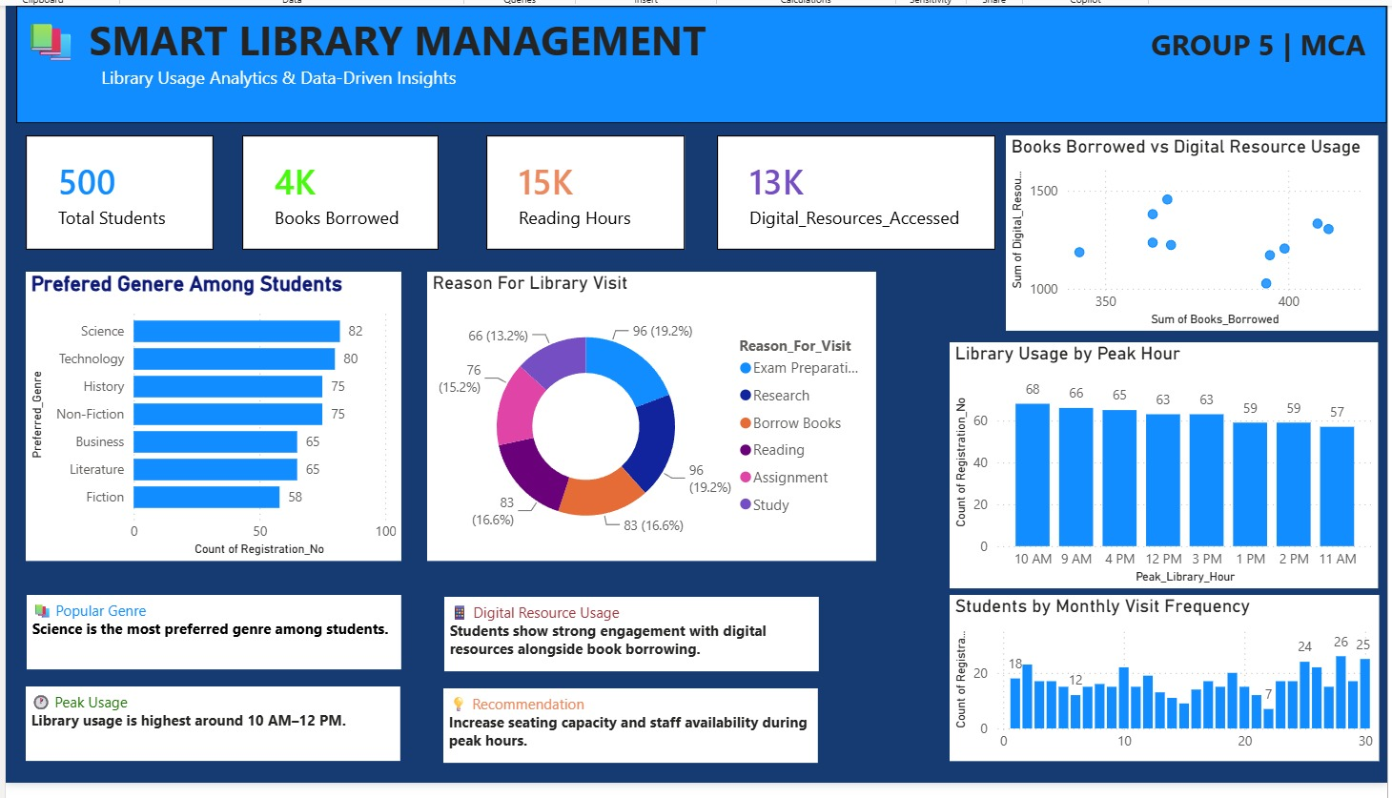
LIVE DEPLOYMENT
Power BI Executive Dashboard
A complementary Power BI report for stakeholders — KPI cards, genre demand, visit-reason mix, peak-hour traffic and monthly visit frequency.
SMART LIBRARY MANAGEMENT | GROUP 5 · MCA
19

Slide 20


FUTURE SCOPE
Enhancements & Extensions
Add a Department Field
Real-time Dashboard
Deep Learning Recommender
Enable department-wise utilization analysis — not fabricated in the current dataset.
Connect the pipeline to live circulation data for continuously updated insights.
Move beyond rule-based suggestions to a collaborative-filtering or embedding model.
Predictive Demand Forecasting
Mobile Self-Service App
Automated Staffing Alerts
Forecast seasonal book demand and peak-hour footfall using time-series models.
Let students view personalized recommendations and reserve resources directly.
Trigger seating/staff-allocation alerts automatically during predicted peak hours.
SMART LIBRARY MANAGEMENT | GROUP 5 · MCA
20

Slide 21
TEAM
Group Members
Group 5 · MCA · Big Data Project
AM
MU
MO
Atish M
Muntazar
Moses
Data Collection
Data Collection
Exploratory Data Analysis (EDA) and PPT Creation
PN
AK
MG
Priyansh Nolkha
Amina Khaatoon
Maharshi Goswami
Data Visualization and Power BI Dashboard
Frontend Deployment of the Project
Data Training and Model Building
SMART LIBRARY MANAGEMENT | GROUP 5 · MCA
21

Slide 22
THANK YOU
Smart Library Management | Library Usage Analytics & Data-Driven Insights
GROUP 5 · MCA · BIG DATA PROJECT
Questions & discussion are welcome.
SMART LIBRARY MANAGEMENT | GROUP 5 · MCA
22

